Slide 1
AI

Slide 2
Artificial Intelligence
Other Logics (from 3.6.3)

Slide 3
Lambda Expressions
Example
inc(x) = λx x+1
then inc(4) = (λx x+1)(4) = 5
Example
add(x,y) = λx,λy(x+y)
then add(3,4) = (λx,λy(x+y))(3)(4)= (λy 3+y)(4) = 3+4 = 7
Useful for semantic parsing (see later)

Slide 4
Modal operators
Beliefs
Knowledge
Assertions
Issues: If you are interested in baseball, the Red Sox are playing tonight.

Slide 5
Representing Time
Example
Martin went from the kitchen to the yard
ISA(e,Going) ^ Goer(e,Martin) ^ Origin (e,kitchen) ^ Target (e,yard)
Issues
no tense information: past? present? future?
PresidentOf (“USA”, “Donald Trump”)
PresidentOf (“USA”, Harry Truman”)
Fluents
A predicate that is true at a given time: T(f,t)

Slide 6
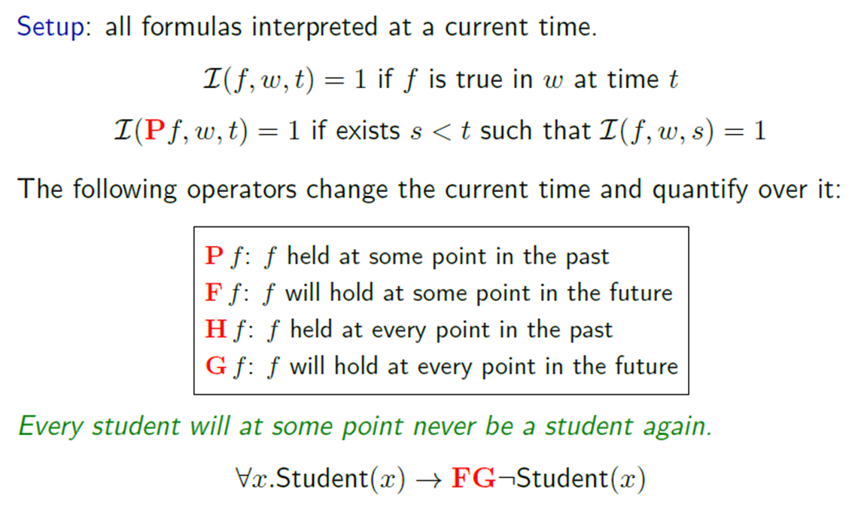
Temporal Logic
Slide from Percy Liang

Slide 7
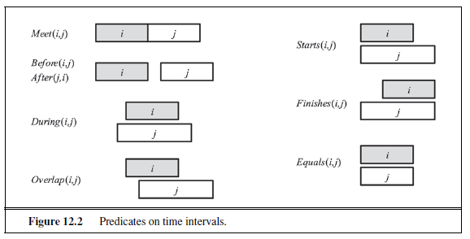
Representing Time
Example from Russell and Norvig

Slide 8
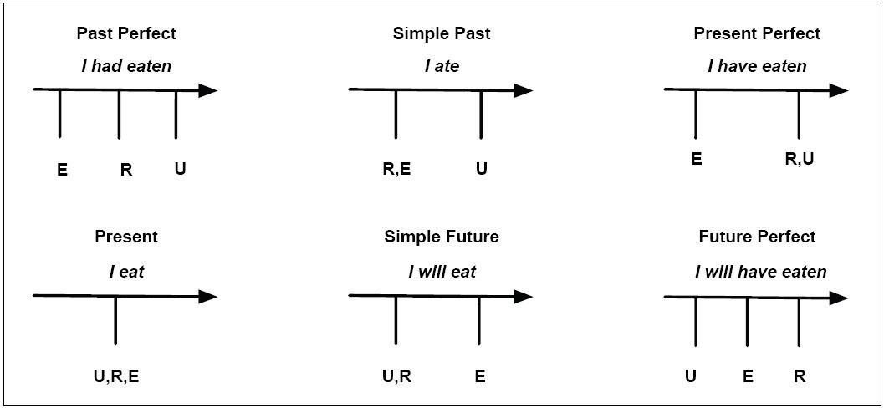
Representing Time
Example from Jurafsky and Martin

Slide 9
Representing time
∃ i,e,w,t: Isa(w,Arriving) ∧ Arriver(w,Speaker) ∧ Destination(w,NewYork) ∧ IntervalOf(w,i) ∧ EndPoint(i,e) ∧ Precedes (e,Now)
∃ i,e,w,t: Isa(w,Arriving) ∧ Arriver(w,Speaker) ∧ Destination(w,NewYork) ∧ IntervalOf(w,i) ∧ MemberOf(i,Now)
∃ i,e,w,t: Isa(w,Arriving) ∧ Arriver(w,Speaker) ∧ Destination(w,NewYork) ∧ IntervalOf(w,i) ∧ StartPoint(i,s) ∧ Precedes (Now,s)
Example from Jurafsky and Martin

Slide 10
Representing time
We fly from San Francisco to Boston at 10.
Flight 1390 will be at the gate an hour now.
Use of tenses
Flight 1902 arrived late.
Flight 1902 had arrived late.
“similar” tenses
When Mary’s flight departed, I ate lunch
When Mary’s flight departed, I had eaten lunch
reference point
Example from Jurafsky and Martin

Slide 11
Aspect
Stative
I know my departure gate
Activity
John is flying (no particular end point)
Accomplishment
Sally booked her flight (natural end point and result in a particular state)
Achievement
She found her gate
Figuring out statives:
I am needing the cheapest fare.
I am wanting to go today.
Need the cheapest fare!
Example from Jurafsky and Martin

Slide 12
Representing Beliefs
Example
Milo believes that Martin ate fish
One possible representation
∃ e,b: ISA(e,Eating) ∧ Eater(e,Martin) ∧ Eaten(e,Fish) ∧ ISA(b,Believing) ∧ Believer(b,Milo) ∧ Believed(b,e)
However this implies (by dropping some of the terms) that “Martin ate fish” (without the Belief event)
Modal logic
Possibility, Temporal Logic, Belief Logic

Slide 13
Representing Beliefs
Want, believe, imagine, know - all introduce hypothetical worlds
I believe that Mary ate British food.
Reified example:
∃ u,v: Isa(u,Believing) ∧ Isa(v,Eating) ∧ Believer (u,Speaker) ∧ BelievedProp(u,v) ∧ Eater(v,Mary) ∧ Eaten(v,BritishFood)
However this implies also:
∃ u,v: Isa(v,Eating) ∧ Eater(v,Mary) ∧ Eaten(v,BritishFood)
Modal operators:
Believing(Speaker,Eating(Mary,BritishFood)) - not FOPC! – predicates in FOPC hold between objects, not between relations.
Believes(Speaker, ∃ v: ISA(v,Eating) ∧ Eater(v,Mary) ∧ Eaten(v,BritishFood))

Slide 14
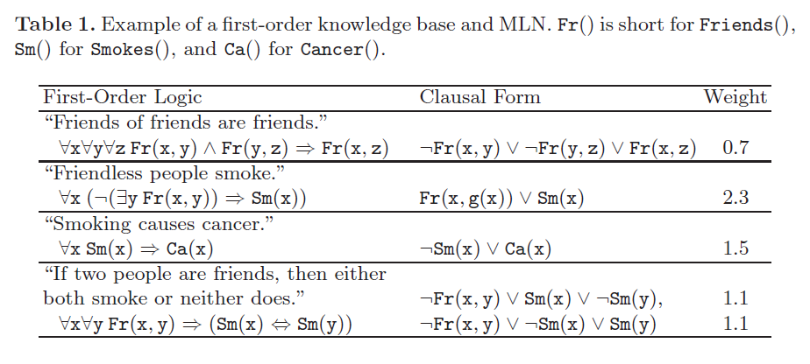
Markov Logic
Distribution over models
Example:
[Domingos et al]

Slide 15
AI

